Slide 1
1. Introduction
Topic 1. Understanding Economic Systems
Chapter 1. Productivity and the Business Cycle
Unit 1. The Context of Business.
MXA101 – Introduction To Business
-By ManageX Academy

Slide 2
Understanding Economic Systems – Why It Matters
Meaning of an economic system
How economies organize production and distribution
Role of businesses, people, and government
Link between economic systems and business success

Slide 3
What Is Productivity in an Economy?
Definition of productivity
Output vs hours worked
Why productivity is a key economic indicator
Relationship between productivity and growth

Slide 4
Why Some Economies Are More Productive
Role of technology and innovation
Skill level of the workforce
Efficient use of resources
Impact on cost of goods and services

Slide 5

Technology as a Productivity Multiplier
Automation and digital tools
Faster production with fewer resources
Examples from manufacturing and services
Technology lowering business costs

Slide 6
Business Organizations in an Economy
For-profit organizations
Not-for-profit organizations
Shared management principles
Difference in goals, similarity in operations

Slide 7

Understanding Not-for-Profit Organizations
Purpose beyond profit
Focus on social impact
Economic contribution of nonprofits
Why nonprofits matter to society

Slide 8
Mission and Vision in Nonprofit Organizations
Importance of shared vision
Alignment between people and purpose
Decision-making driven by mission
Long-term sustainability of nonprofits

Slide 9
Case Insight – Purpose-Driven Organizations
Mission-led problem solving
Rapid response and execution
Use of skilled human resources
High engagement and motivation

Slide 10
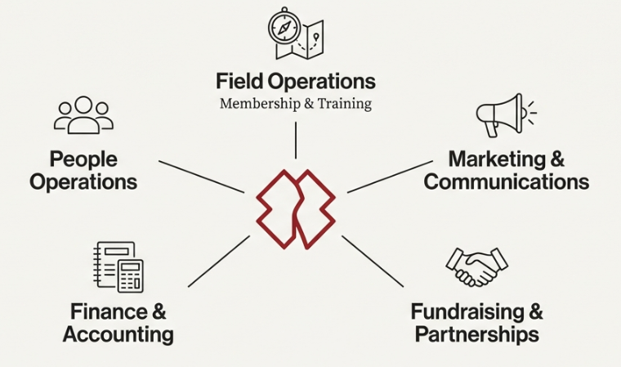
How Nonprofits Operate Like Businesses
Structured departments and roles
Operations, marketing, finance, and HR
Performance measurement
Strategic planning and execution

Slide 11
Role of Volunteers and Human Capital
Skilled volunteers as a strategic asset
Cost efficiency and flexibility
Training and deployment
Leadership development opportunities

Slide 12
Funding and Partnerships
Donations and grants
Corporate partnerships
Strategic alliances
Importance of trust and transparency

Slide 13
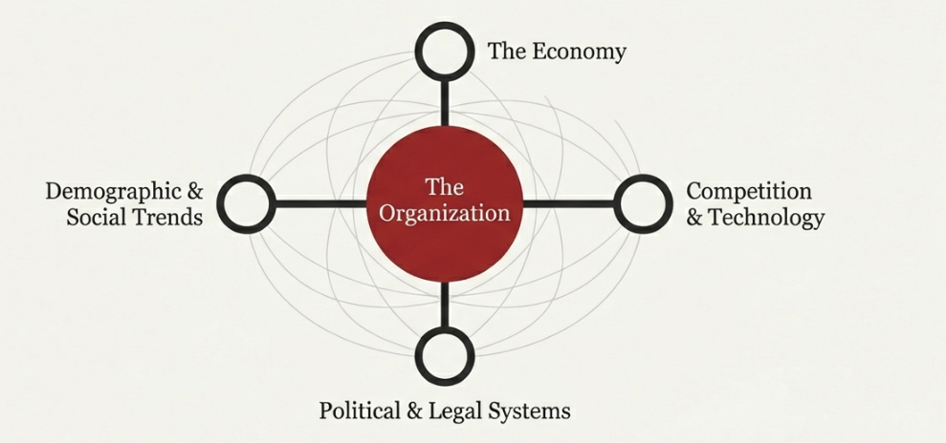
The Business Environment Explained
Internal vs external environment
Economic, social, political, and legal forces
Competitive pressures
Constant change as a business reality

Slide 14
Risk, Profit, and Survival
Relationship between risk and reward
Why many businesses fail early
Importance of adaptability
Strategic decision-making

Slide 15
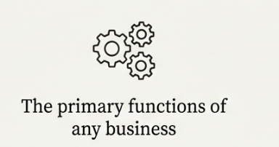
Economic Systems and Business Activity
How economies create jobs
Role of consumers and producers
Competition among businesses
Value creation process

Slide 16

Role of Government in Economic Systems
Taxation and incentives
Regulation of markets
Support for economic stability
Influence on business decisions

Slide 17
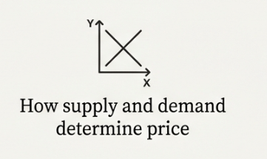
Supply and Demand Basics
Demand driven by consumer needs
Supply driven by production capacity
Price determination
Market equilibrium

Slide 18

Economic Cycles and Business Impact
Expansion and growth phases
Slowdowns and recessions
Business risks during cycles
Importance of planning

Slide 19

Managing Change in Business
Change as the only constant
Tracking trends and signals
Innovation and flexibility
Strategic foresight

Slide 20
Key Skills for Future Managers
Economic awareness
Strategic thinking
Data-driven decisions
Purpose-led leadership

Slide 21
Key Takeaways – Economic Systems & You
Economic systems shape opportunities
Productivity drives prosperity
Purpose and profit can coexist
Adaptability defines success

Slide 22


